Slide 1

framework
Politeknik Gajah Tunggal
Rabu, 25 Juni 2025
Rio Bastian

Slide 2
Materi
Sejarah Spring framework (a story 🌱)
Apa itu Spring framework
Spring Boot
Spring MVC
Spring Security

Slide 3

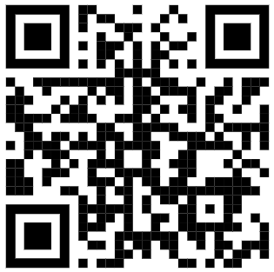


Sejarah Spring framework (a story 🌱)
2000
Java EE sebagai standar pembuatan website pada saat itu,
di anggap terlalu rumit
2002
Rod Jhonson membuat pondasi Spring Framework
2003
Spring Framework v1.0 lahir
2004 - 2010
Di adopsi secara luas oleh Komunitas Java, dan menjadi framework paling popular pada saat itu, AOP, MVC lahir
di kembangkan oleh Spring Source
2013 - 2014
Spring Boot release, di kembangkan oleh Pivotal
2019 - Now
Spring Cloud Microservices, di kembangkan oleh VMware

Slide 4

Apa itu Spring framework (🌱) (1/4)
“Spring Framework is a Java platform
that provides comprehensive infrastructure support
for developing Java applications.”
~ docs.spring.io ~
“What if we let a container manage object creation and wiring for us.”
~ Rod Jhonson ~

Slide 5
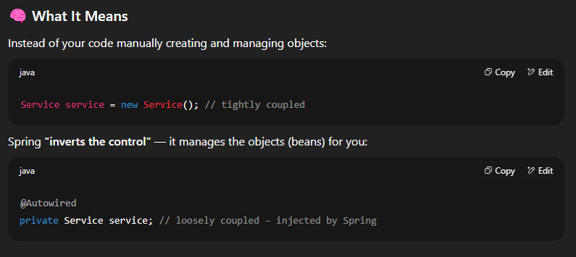
Apa itu Spring framework (🌱)(2/4)
ApplicationContext
Beans
@Component
@Bean
@Autowired

Slide 6
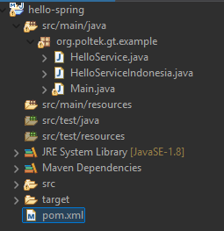
Practice #1 (3/4)
create a Maven project
Run `mvn clean install`
Run as Java application

Slide 7
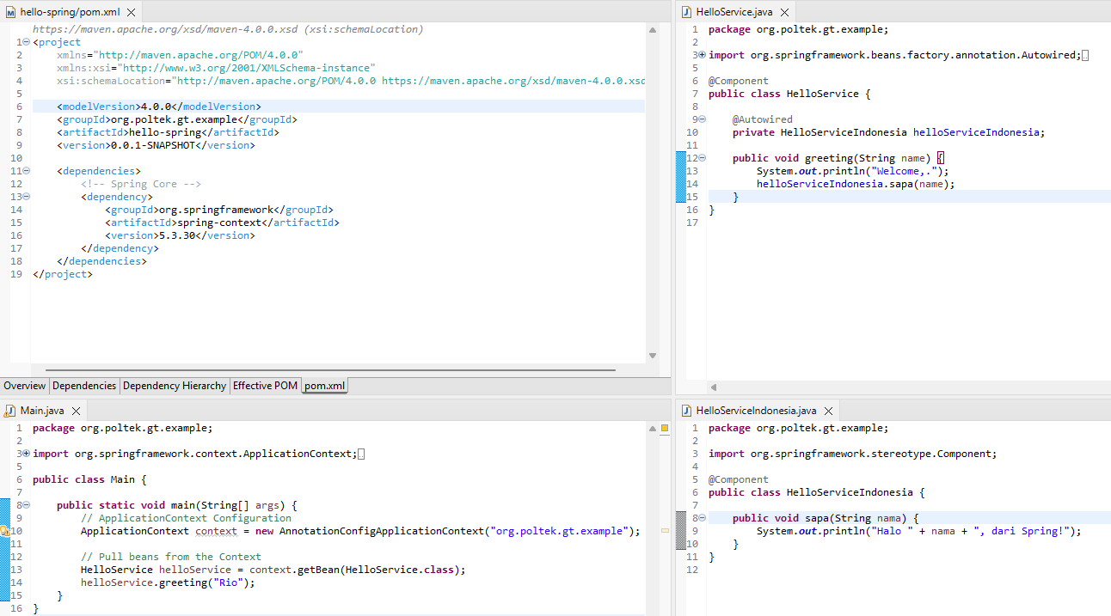
Practice #1 (4/4)

Slide 8

Apa itu Spring Boot ( )(1/7)
“Spring Boot makes it easy to create stand-alone,
production-grade Spring based Applications
that you can ‘just run’..”
~ spring.io ~
2014
SpringBoot 1.0 released
2020
SpringBoot 2.3 released
Support Docker
2018
SpringBoot 2.0 released
Support Reactive Programming
2022
SpringBoot 2.7 released
Long Term support
2023
SpringBoot 2.7 released
Support java 17

Slide 9
Spring Boot feature ( )(2/7)
Auto Configuration
Profile Based config
Application Monitoring
Logging
Hot deploy

Slide 10
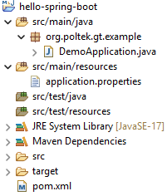
Practice #2 (3/7)
create a Maven project
$ mvn -e clean compile spring-boot:run

Slide 11
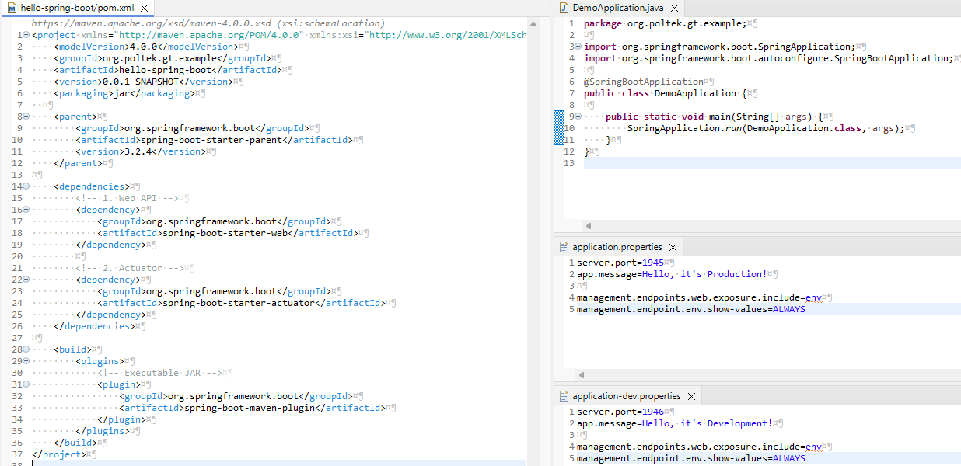
Practice #2 (4/7)

Slide 12
Practice #3 (5/7)
Create new properties files :
application-dev.properties
-Dspring-boot.run.profiles=dev
Use Actuator to monitor application metric

Slide 13
Practice #4 (6/7)
logging.level.root=INFO logging.level.org.springframework.web=DEBUG
Option :
DEBUG
INFO
WARN
ERROR
TRACE

Slide 14
Practice #4 (7/7)
<dependency>
<groupId>org.springframework.boot</groupId>
<artifactId>spring-boot-devtools</artifactId>
<scope>runtime</scope>
<optional>true</optional>
</dependency>

Slide 15
Exercise
cari tau bagaimana cara restart SpringBoot service dengan menggunakan Actuator
cari tau bagaimana cara setup Format Log

Slide 16
Apa itu Spring MVC ( )(1/11)
“Spring MVC (Model-View-Controller) is a web framework within the Spring Framework that is used to build Java web applications, especially REST APIs and web UI’s.”
~ spring.io ~
Model
Java classes or Service
@Service
@Component
@Entity
Controller
Controller and Dispatcher
@Controller
@Rest Controller
@Rest Mapping
View
Response representative
Thymeleaf
JSP
Json

Slide 17
Spring MVC annotation ( )(2/11)
@RestController
class level annotation, penanda bahwa class tersebut handle Web Request dan mengembalikan response dalam bentuk Data (Json, XML)
@RequestMapping
class/method level annotation, digunakan untuk routing path ke method yang di inginkan

Slide 18
Spring MVC annotation ( )(3/11)
@GetMapping/@PostMapping
method level annotation, specialized version dari RequestMapping di level method
@PathVariable
Parameter binding annotation, digunakan untuk binding Path variable
@RequestParam
Parameter binding annotation, digunakan untuk bind Request parameter

Slide 19
Spring MVC annotation ( )(4/11)
@RequestBody
Parameter binding annotation, di gunakan untuk bind HTTP Request body
@Valid
POJO validation, mengacu ke standar JSR-380 (Jakarta Bean Validation) digunakan untuk Validasi attribute/variable dalam sebuah class.

Slide 20
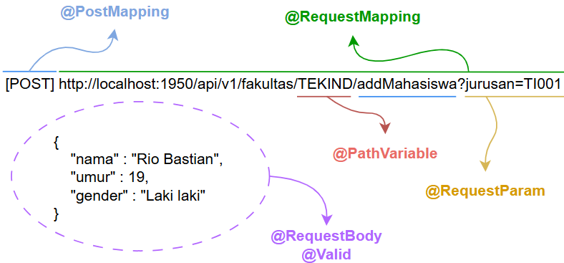
Spring MVC annotation ( )(5/11)

Slide 21
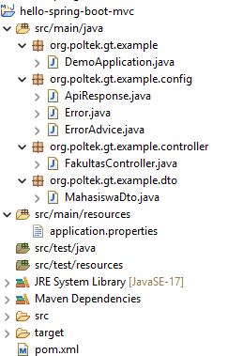
Practice #5 (6/11)
create a Maven project

Slide 22
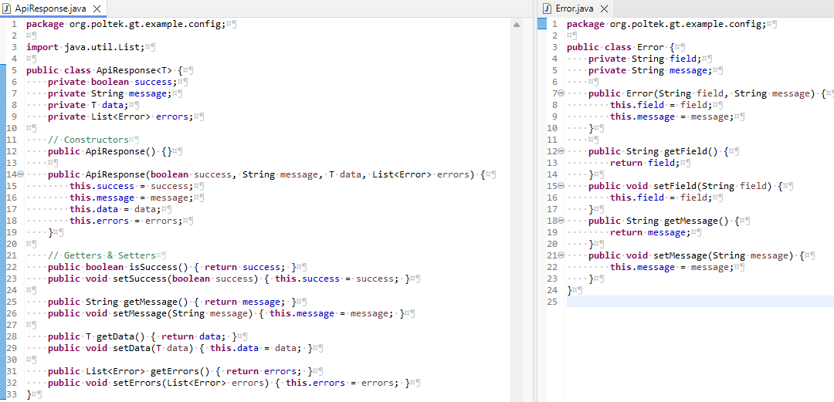
Practice #5 (7/11)

Slide 23
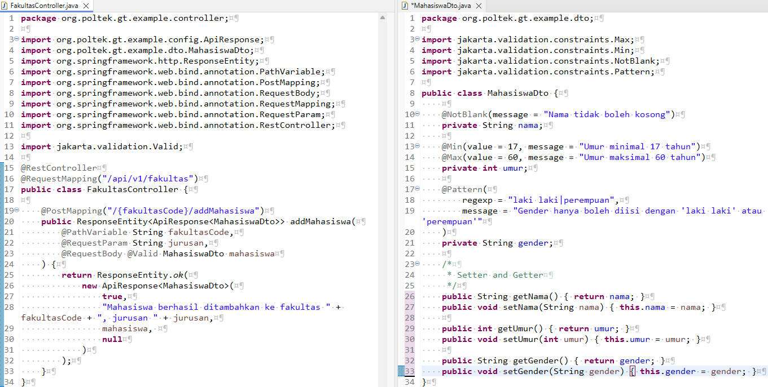
Practice #5 (8/11)

Slide 24
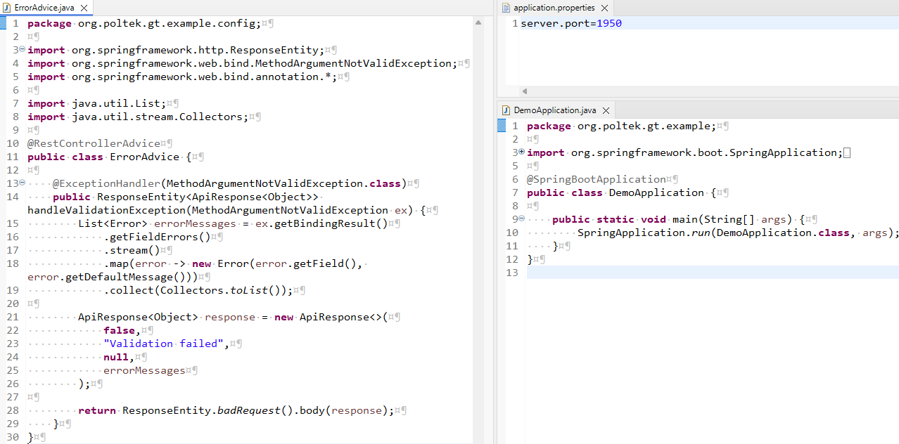
Practice #5 (9/11)

Slide 25
Practice #6 (10/11)
<!-- 4. Security -->
<dependency>
<groupId>org.springframework.boot</groupId>
<artifactId>spring-boot-starter-security</artifactId>
</dependency>

Slide 26
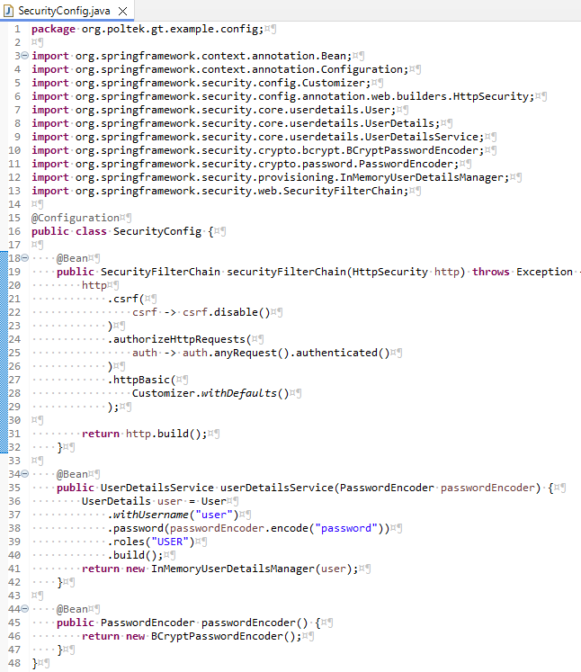
Practice #6 (11/11)

Slide 27
Exercise
cari tau bagaimana cara login dengan Basic auth yang di ambil dari Database

Slide 28
Apa itu Spring Data ( )(1/7)
“Spring Data is a Spring project that simplifies working with databases and data access in Java applications.
It helps avoid writing boilerplate code by providing a powerful abstraction layer over various data stores.”
~ spring.io ~

Slide 29
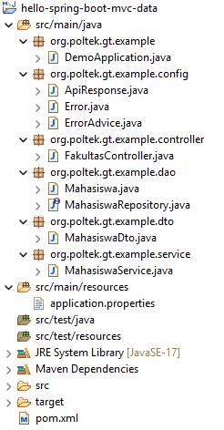
Practice #7 (6/11)
create a Maven project

Slide 30
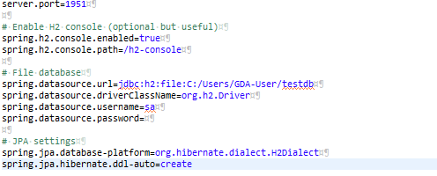
Practice #7 (6/11)
application.properties

Slide 31
Practice #7 (6/11)
pom.xml
http://localhost:1951/h2-console
<dependency>
<groupId>org.springframework.boot</groupId>
<artifactId>spring-boot-starter-data-jpa</artifactId>
</dependency>
<dependency>
<groupId>com.h2database</groupId>
<artifactId>h2</artifactId>
<scope>runtime</scope>
</dependency>

